Slide 1


BASICS OF WEB DEVELOPMENT
Delivered by Victor Olaoluwa Adeoti at the 2026 Chapter Conference of Anglican Students’ Fellowship (ASF) Ondo Chapter

Slide 2


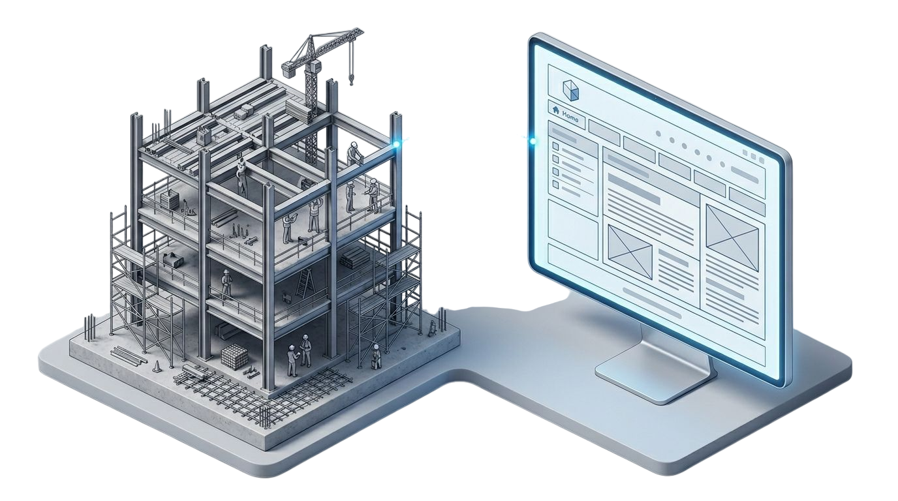
What is Web Development
Web development is the process of building and maintaining websites and web applications that operate over the internet. It is not a single discipline, but a broad field encompassing several distinct specializations.
Think of constructing a modern office building. You require architects to design the layout and appearance, structural engineers to ensure it is functional and secure, and specialists to handle electrical and plumbing systems. Web development follows a similar model, which we categorize into three primary areas:
1. Front-End Development (Client-Side): This concerns everything the user directly experiences. It includes the visual layout, typography, color schemes, buttons, forms, and all interactive elements. The front-end developer translates design files into code that a browser can render.
2. Back-End Development (Server-Side): This is the invisible infrastructure that powers the front-end. It consists of a server, an application, and a database. When a user logs into a portal, the back-end code authenticates their credentials against a database and returns the correct data. It is concerned with logic, security, and data management.
3. Full-Stack Development: A professional proficient in both front-end and back-end systems. A full-stack developer can build a complete, functional application from the user interface down to the database layer.

Slide 3


Core Languages and Their Functions
· HTML (HyperText Markup Language): The Skeletal Structure
HTML provides the fundamental structure and semantic meaning of a webpage. This is the skeleton. It defines what an element is—a heading, a paragraph, an image, a navigation bar, It uses a system of tags (e.g., <h1>, <p>, <div>) to annotate content. There's no structure without HTML, It's the fundamental layout
· CSS (Cascading Style Sheets): The Presentation Layer
CSS controls the visual presentation and layout. This is the skin, physique, and clothing. It defines how the skeleton looks—its colors, dimensions, positioning, and typography. A single CSS rule can style multiple elements, ensuring consistency. It handles responsiveness, allowing the same website to display correctly on a desktop, tablet, or mobile phone.
· JavaScript: The Interactive and Behavioral Layer
JavaScript (JS) is a dynamic programming language that adds interactivity and complex functionality. This is the muscular and nervous system. It enables movement and decision-making. JS allows for actions like real-time form validation, animated graphics, dynamically updating content without reloading the page, and fetching data from servers. It is the only language that runs natively in the browser.

Slide 4
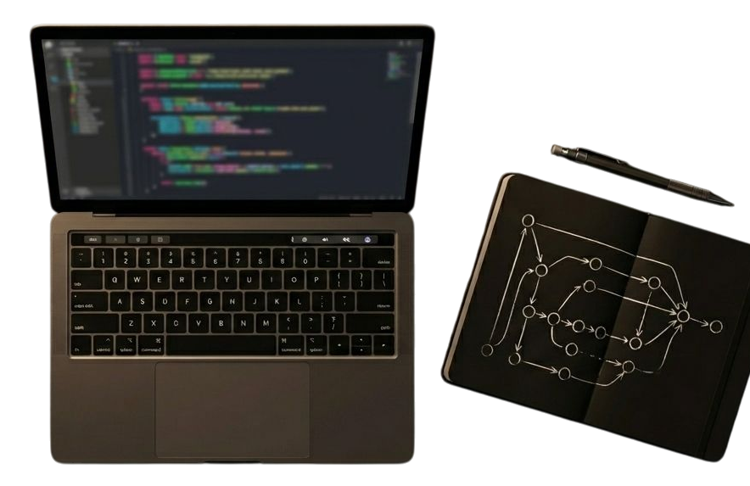
Essential Software and Platforms
· Code Editor: Visual Studio Code (VS Code)
This is the primary instrument for writing code. It is a powerful, free, open-source editor from Microsoft. Key features include syntax highlighting, auto-completion (IntelliSense), and an extensive library of extensions that add functionality for different languages and workflows. It is the industry standard.
Other examples include Sublime Text, Bracket......... They are also available on Mobile phones too
· Browser Developer Tools
Every modern browser (Google Chrome, Mozilla Firefox) contains a suite of developer tools. By right-clicking on any webpage and selecting "Inspect," you can view the source code, live-edit HTML and CSS to test changes, and debug JavaScript. It is an invaluable learning and diagnostic resource.

Slide 5


The Role of Web Development in the Modern Economy
Web development is not an isolated skill; it is a fundamental layer of modern socio-economic infrastructure. Its importance is evident across all sectors:
· Commerce: E-commerce platforms, and payment gateways are all web applications.
· Education: Online learning platforms, digital libraries, and student management portals are critical tools built by web developers.
· Information Dissemination & Media: News, public health advisories, and official communications are delivered primarily through web channels.
The ability to build and control these platforms transforms an individual from a passive consumer of technology into an active architect of digital solutions.

Slide 6


The Roadmap to Competency
· Phase 1: Static Structure and Style
· Focus: Master HTML5 semantic elements and CSS3, including Flexbox and Grid for layout.
· Practical Project: Clone the visual layout of a simple, professional website (e.g., a news site landing page).
· Phase 2: Interactivity and Logic
· Focus: Learn core JavaScript fundamentals—variables, functions, DOM manipulation, and API fetching.
· Practical Project: Build an interactive dashboard element, like a task counter or a data-driven chart.
· Phase 3: Full-Stack Systems (Months 6+)
· Focus: Select a back-end language (such as Node.js with Python, or Python with Django) and a database system (like PostgreSQL or MongoDB).
· Practical Project: Develop a full-stack CRUD (Create, Read, Update, Delete) application—for example, a blog CMS or an inventory tracking system.

Slide 7

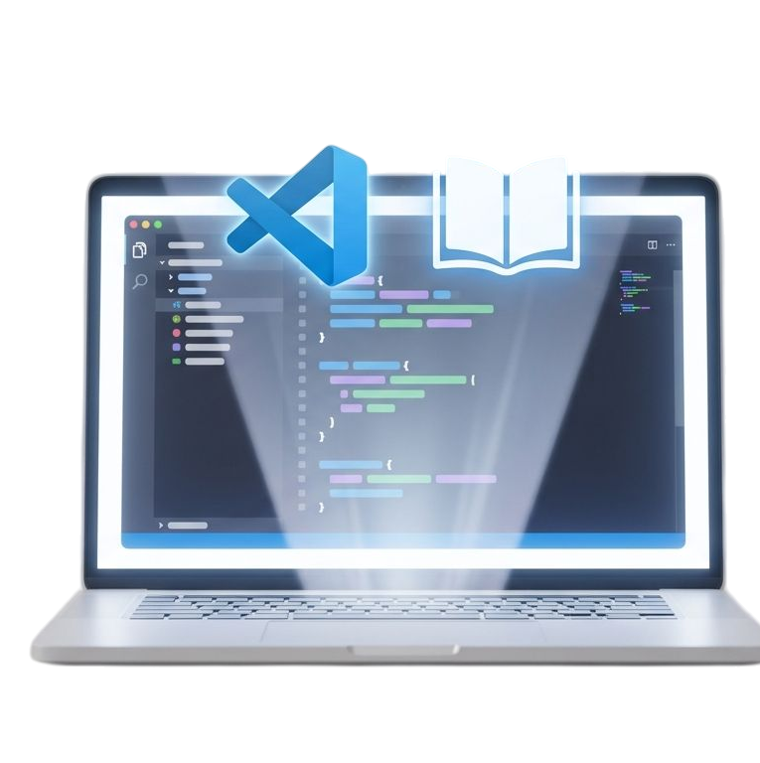
First Steps
To begin, you do not require perfection. You need a teachable heart, A mobile phone or a PC and consistency
· Step 1: Download and install Visual Studio Code or any other Code Editor
· Step 2: Find a highly-rated, beginner-level HTML tutorial on platforms like freeCodeCamp, Udemy, or YouTube.
· Step 3: Write your first index.html file and open it in a browser. Commit to learning with consistency, not just intensity.
The barrier to entry is lower than it has ever been. The resources are open and abundant. The demand for competence is high. The next step is yours.

Slide 8

THANK YOU
ASF……… Arise
ASF………Shine
ASF………Restoring the ancient Landmark

